Slide 1

Principles of
Operating System
File System Implementation

Slide 2


Roadmap
File System Structure and Implementation
Directory Implementation
Allocation Methods
Free-Space Management
Recovery

Slide 3
File-System Structure
Characteristics of disks
  Can be rewritten in place
  Can access directly any given block of information
Operating system imposes one or more file systems to allow the data to be stored, located, and retrieved easily
  To provide an efficient and convenient access to the disk

Slide 4
File-System Structure (cont.)
Design problems
  Defining how the file system should look to the user
    Involves defining a file and its attributes, the operations allowed on a file, and the directory structure for organizing files.
  Creating algorithms and data structures to map the logical file system onto the physical secondary-storage devices.

Slide 5
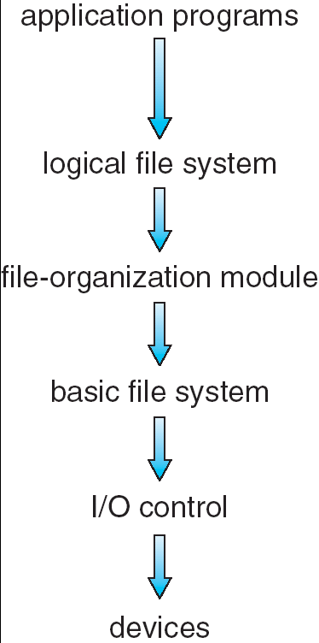
Layered File System
The file system itself is generally composed of different levels.
Manages metadata information, and manages the directory structure to provide the file-organization module
Knows about files, their logical blocks, and physical blocks. Can translate logical block addresses to physical block addresses
Generic commands to the appropriate device driver to read and write physical blocks on the disk
Consists of device drivers and interrupt handlers to transfer information between the main memory and the disk system

Slide 6
Implementation
On-disk, the file system may contain information about:
  How to boot an operating system stored there
  The total number of blocks
  The number and location of free blocks
  The directory structure
  Individual files.
A file control block (FCB) contains information about the file.

Slide 7
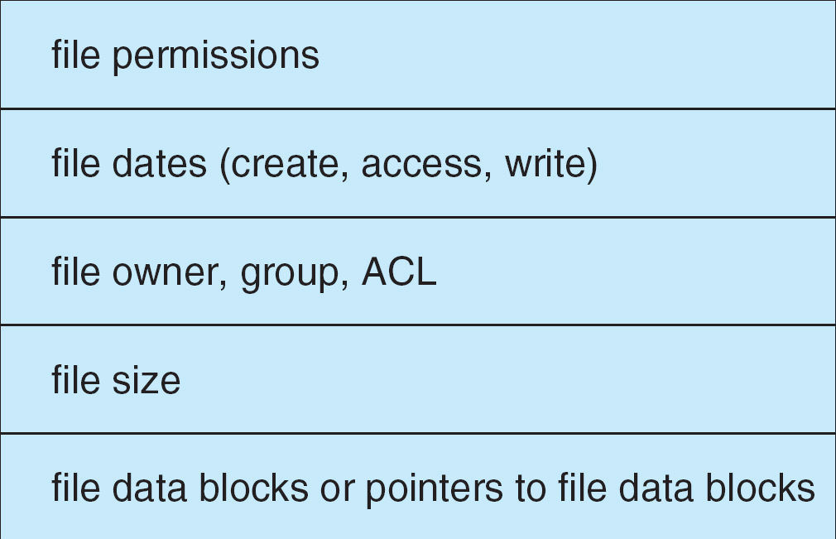
A Typical File Control Block

Slide 8
The On-disk Structures
The on-disk structures include:
  A boot control block can contain information needed by the system to boot an operating from that partition.
  A partition control block contains details of blocks.
  A directory structure is used to organize the files.
  An FCB contains many of file’s details.

Slide 9
Create A New File
To create a new file, an application program calls the logical file system.
The logical file system
  Allocates a new FCB
  Reads the appropriate directory into memory
  Updates it with the new file name and FCB
  Writes it back to the disk.

Slide 10
Open File
The open call passes a file name to the file system.
When a file is opened, the directory structure is searched for the given file name.
  Once the file is found, the FCB is copied into a system – wide open-file table
  An entry is made in the per-process open-file table with a pointer and other fields
The open call returns a pointer to the appropriate entry in the per-process file-system table.
  All file operations are then performed via this pointer

Slide 11
Close File
When a process closes the file
  The per-process table entry is removed
  The system-wide entry’s open count is decremented.
When all users that have opened the file close it
  The updated file information is copied back to the disk-based directory structure
  The system-wide open-file table entry is removed.

Slide 12

In-Memory File System Structures
open file
read file

Slide 13
Virtual File Systems
Implementation details
  How does an operating system allow multiple types of file systems to be integrated into a directory structure
  How can users seamlessly move between file-system types as they navigate the file-system space
A simple solution
  Write directory and file routines for each type of file system

Slide 14
Virtual File Systems (cont.)
Virtual File Systems (VFS) provide an object-oriented way of implementing file systems.
  VFS allows the same system call interface (the API) to be used for different types of file systems.
  The API is to the VFS interface, rather than any specific type of file system.

Slide 15

Schematic View of Virtual File System
Based on the open, read, write, and close calls, and file descriptors
Two functions:
separates file-system-generic operations from their implementation by defining a clean VFS interface
based on a file-representation structure

Slide 16
Roadmap
File System Structure
Directory Implementation
Allocation Methods
Free-Space Management
Recovery

Slide 17
Directory Implementation
Linear list of file names with pointer to the data blocks.
  simple to program
  time-consuming to execute
Hash Table – linear list with hash data structure.
  decreases directory search time
  collisions – situations where two file names hash to the same location
  fixed size

Slide 18
Roadmap
File System Structure
Directory Implementation
Allocation Methods
Free-Space Management
Recovery

Slide 19
Allocation Methods
An allocation method refers to how disk blocks are allocated for files:
  Contiguous allocation
  Linked allocation
  Indexed allocation

Slide 20
Contiguous Allocation
Each file occupies a set of contiguous blocks on the disk.
Simple: only starting location (block #) and length (number of blocks) are required.
Random access.
Wasteful of space (dynamic storage-allocation problem).
Files cannot grow.

Slide 21

Contiguous Allocation of Disk Space

Slide 22
Extent-Based Systems
Many newer file systems (i.e. Veritas File System) use a modified contiguous allocation scheme.
Extent-based file systems allocate disk blocks in extents.
An extent is a contiguous block of disks. Extents are allocated for file allocation. A file consists of one or more extents.

Slide 23
Linked Allocation
Each file is a linked list of disk blocks:
  Blocks may be scattered anywhere on the disk.
Simple: need only starting address
Free-space management system
  No waste of space
No random access
block =
pointer

Slide 24

Linked Allocation

Slide 25

File-Allocation Table (FAT)

Slide 26
Indexed Allocation
Brings all pointers together into the index block.
Logical view.
index table

Slide 27

Example of Indexed Allocation

Slide 28
Indexed Allocation (Cont.)
Need index table
Random access
Dynamic access without external fragmentation, but have overhead of index block.
Mapping from logical to physical in a file of maximum size of 256K words and block size of 512 words. We need only 1 block for index table.

Slide 29

Combined Scheme: UNIX (4K bytes per block)

Slide 30
Roadmap
File System Structure
Directory Implementation
Allocation Methods
Free-Space Management
Recovery

Slide 31
Free-Space Management
Bit vector (n blocks)
0
1
2
n-1
…
1 ⇒ block[i] free
0 ⇒ block[i] occupied
bit[i] =

e.g.,
The free blocks are 2, 3, 4, 5, 8, 9, 10, 11, 12, 13, ...
The free-space bit map is
    0 0 1 1 1 1 0 0 1 1 1 1 1 1 0 0
Block number calculation:
(number of bits per word)*(number of 0-value words)+offset of first 1 bit

Slide 32
Free-Space Management (Cont.)
Bit map requires extra space.
  Example:
    block size = 2¹² bytes
    disk size = 2³⁰ bytes (1 gigabyte)
    n = 2³⁰/2¹² = 2¹⁸ bits (or 32K bytes)
Easy to get contiguous files

Slide 33

Free-Space Management (Cont.)
Linked list (free list)
  Cannot get contiguous space easily
  No waste of space
Grouping
  first free block stores n free block
Counting
  for contiguous allocation, record first and last free block

Slide 34
Roadmap
File System Structure
Directory Implementation
Allocation Methods
Free-Space Management
Recovery

Slide 35
Recovery
Consistency checking: compares data in directory structure with data blocks on disk, and tries to fix inconsistencies.
Use system programs to back up data from disk to another storage device (floppy disk, magnetic tape).
Recover lost file or disk by restoring data from backup.

Slide 36
Principles of
Operating System
End of File System Implementation

